Slide 1


Slide 2
Cost Function
The concept of cost function refers to the mathematical relation between cost of a product and its various determinants of costs.
C= f(O,S,T,P…….)
Where , C= Cost ,
S = size of plant ,
O= Output ,
T= Time ,
U= utilization of output ,
P = Prices of factors of production.

Slide 3
Determinants of costs
Laws of returns
Size of Plant
Period
Capacity Utilization
Prices of Factors
Technology
Stability in output

Slide 4

1.Money Cost
Money cost is also known as the nominal cost. It is nothing but the expenses incurred by a firm to produce a commodity.
For instance, the cost of producing 400 chairs is Rs. 20000, and then it will be called the money cost of producing 400 chairs.

Slide 5
Examples
(i) Depreciation and obsolescence charges.
(ii) Power fuel charges.
(iii) Wages and salaries.
(iv) Cost of machinery, raw material etc.
(v) Expenses on advertising and publicity,
(vi) Interest on capital.
(vii) Expenses on electricity.
(viii) Insurance charges.
(ix) Transport costs.
(x) Packing charges.
(xi) All types of taxes viz; property tax, license fees, excise duty.
(xii) Rent on land.

Slide 6
(1A) Explicit Costs
Explicit costs refer to all those expenses made by a firm to buy goods directly. They include, payments for raw material, taxes, transportation, power, high fuel, advertising and so on.
According to Leftwitch, “Explicit costs are those cash payments which firms make to outsiders for their services and goods.” He has given stress on the word explicit and it may be called the approach used by the accountant of the firm. The payments are explicit-clear-cut, paid to agents (owners) of factors of production. A contract fixes the rate at which the payments are to be made.
They are also known as Accounting Costs or Historical Costs.

Slide 7
(1B) Implicit Costs
Implicit costs are the imputed value of the entrepreneur’s own resources and Services.
These costs refer to the implied or unnoticed costs. They include the interest on his own capital, rent on his land, wages of his own labor etc.
These costs go to the entrepreneur himself and are not recorded in practice.
In the words of Leftwitch, “Implicit costs are the costs of self-owned, self employed resources.”

Slide 8

2. Real Costs
It is a philosophical concept which refers to all those efforts and sacrifices undergone by various members of the society to produce a commodity.
According to Marshall, “Real costs are the exertion of all the different kinds of labor that are directly or indirectly involved in making it together with the abstinence rather than the waiting required for saving the capital used in making it, all these efforts and sacrifices together will be called the real cost of production of the commodity.”

Slide 9
3.Opportunity Costs
Opportunity cost is the cost of production of any unit of commodity for the value of factors of production used in producing other unit.
It is also known as the alternative cost or transfer cost.
According to Prof. Benham, “The opportunity cost of anything is the next best alternative that could be produced instead by the same factors or by an equivalent group of factors, costing the same amount of money.”
Here, one thing is worth-mentioning that if a factor of production has no alternative use; in that case its opportunity cost will be zero.

Slide 10
Importance of Opportunity Costs:
The concept of opportunity cost has a very wide application in economic theory and policy.
Since, there is scarcity of goods and services they can be put to alternative uses and thus command price.
It is applicable in the determination of factor prices.
It can also be applied to consumption and public expenditure.
Opportunity costs also explain the phenomenon of prices.

Slide 11
Limitations of Opportunity cost
This concept is not applicable for specific factor use.
This concept rests on the assumption of perfect competition.
This costs can not be Recorded. We can not show this cost in the books of accounts.
The forgone opportunities are often unascertainable.

Slide 12
4. Direct Costs & Indirect Costs
Direct costs or traceable costs are readily identified & are traceable to a particular product, operation or a plant.
These costs include expenses such as those related with production like product designing , project preparing etc.
Indirect Costs are not readily identified nor visibly traceable to specific goods, services, operations etc, but are not charged to job or product.
Electric power costs incurred for general operation of business benefitting all the products jointly.

Slide 13
Incremental Cost and Sunk cost
Incremental cost – denotes the total additional costs associated with the marginal batch of output
Sunk cost – are cost that are not affected or altered by a change in the level or nature of activity.

Slide 14
Historical cost and Replacement cost
Historical cost – is the actual cost of an asset incurred at the time the asset was acquired
Replacement cost – means the price that would have to be paid currently for acquiring the same plant

Slide 15
5. Controllable & Non Controllable Costs
Controllable costs are those costs which are capable of being controlled or regulated by executive vigilance.
E.g.. Inventory costs can be controlled at shop level.
Non Controllable costs are those costs which are not capable of being controlled or regulated by executive vigilance.
E.g.. Costs incurred due to obsolete technology & depreciation.

Slide 16
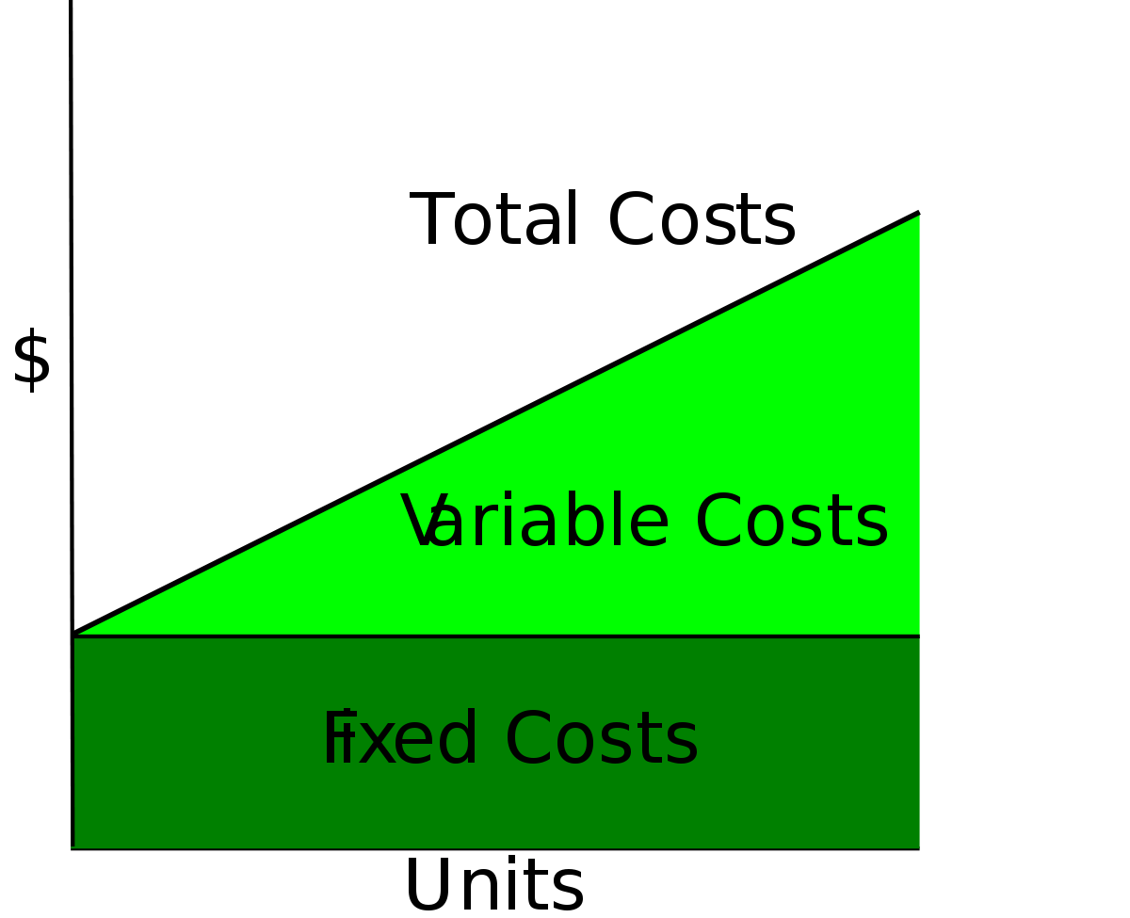
6.Total costs
The total amount of money spent in production of goods & services is known as total costs.
In short period total costs are of two types :
Total fixed cost ( TFC)
Total variable costs (TVC)
TC=TFC+TVC

Slide 17
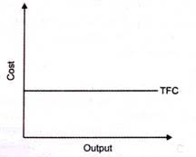
Fixed costs / Supplementary costs
Fixed costs are those costs which do not change with the change of output.
Production may be maximum or zero, fixed costs remains the same .
Examples :
Rent of building
Interest on capital
Property taxes
Insurance premium
License fees
Salaries of permanent staff etc.

Slide 18
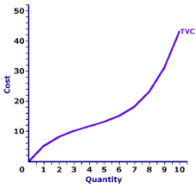
Variable costs or Prime costs
Variable costs are those costs which change with the change of output.
These are incurred on the use of variable costs of production.
Examples :
Expenses on raw material.
Wages of labour.
Electricity charges.
Wear & tear Expenses.
Transportation costs etc.

Slide 19
Output | TFC | TVC | TC | AFC | AVC | ATC | MC
0 | 10 | 0 | 10 | - | - | - | -
1 | 10 | 10 | 20 | 10 | 10 | 20 | 10
2 | 10 | 18 | 28 | 5 | 9 | 14 | 8
3 | 10 | 24 | 34 | 3.3 | 8 | 11.3 | 6
4 | 10 | 28 | 38 | 2.5 | 7 | 9.5 | 4
5 | 10 | 32 | 42 | 2 | 6.4 | 8.4 | 4
6 | 10 | 38 | 48 | 1.7 | 6.3 | 8 | 6
7 | 10 | 46 | 56 | 1.4 | 6.6 | 8 | 8
8 | 10 | 62 | 72 | 1.2 | 7.8 | 9 | 16
TC= TFC+TVC , AFC= TFC/ OUTPUT ,
AVC= TVC/OUTPUT , ATC=AFC+AVC , MC= (TCn – TCn-1)

Slide 20
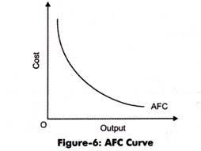
Average Fixed Cost (AFC)
AFC refers to fixed cost per unit of output .
AFC diminishes with every increase in the quantity of output produced as the fixed cost is spread over the large number of units.
AFC never becomes zero.

Slide 21
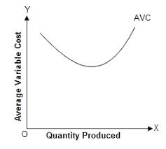
Average Variable Cost (AVC)
AVC refers to the variable expenses per unit of output.
The AVC is falling , but it begins to rise after a certain point.
This happens because in the initial stage of production , the law of increasing returns operates which causes the cost to diminish.
But after a point , variable cost begins to rise due to law of diminishing returns.
hence the AVC curve is u shaped.

Slide 22
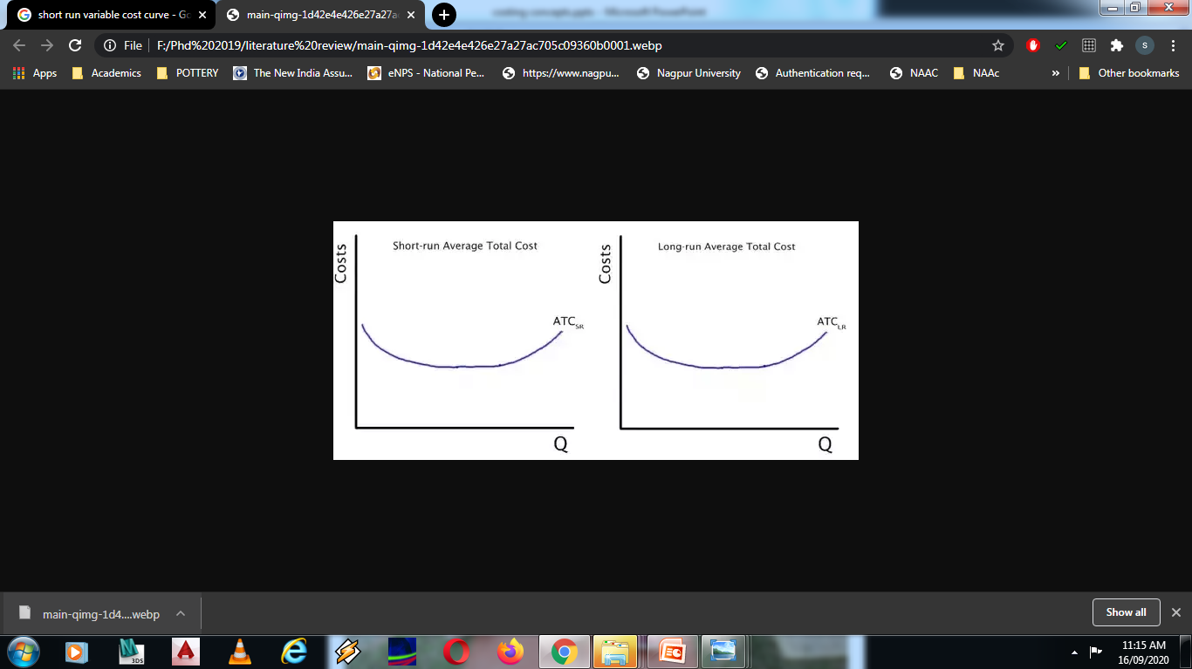
Average Total Cost (ATC)
AVC refers to cost per unit of output.
ATC depends upon the behavior of AFC & AVC.
AFC & AVC falls causing ATC to fall sharply .
However with the further increase in the output there is a sharp rise in the AVC which more than offsets the fall in AFC , thereby causing ATC to rise.
ATC becomes U shaped.

Slide 23
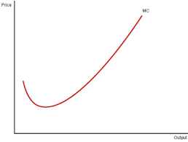
Marginal Cost ( MC)
Addition made to the total cost as result of the production of one more unit of a commodity is called as Marginal Cost.
At first MC curve falls and then it begins to rise.
MC curve is also U shaped as in the beginning , MC declines as output expands , thereafter it remains constant for a while and then starts rising upwards.

Slide 24
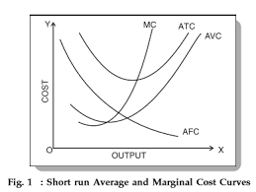
Relation Between MC & AC
Both ATC & MC are calculated from TC.
When ATC Falls, MC are falls & cuts ATC from below.
When ATC rises, MC also rises.
MC cuts AC at its lowest point.
MC & AC are used in price determination.

Slide 25
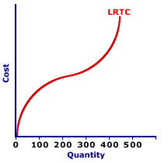
Long run Total Cost Curve
The long run total cost of production is the least possible cost of producing any given level of output when all the inputs are variable.
LTC is always less or equal to the short run total cost.
LTC represents the least cost of different quantities of output.

Slide 26
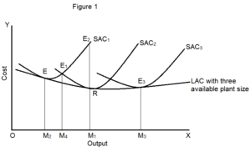
Long run Average Cost Curve
It is called as planning horizon where entrepreneurs can plan ahead considering lower ATC.
Long run consists of all possible short run situation.
A firm always operates in short run but plants in long run.
In long run firm can install new plant whose size leads to least ATC to expand its operations.

Slide 27
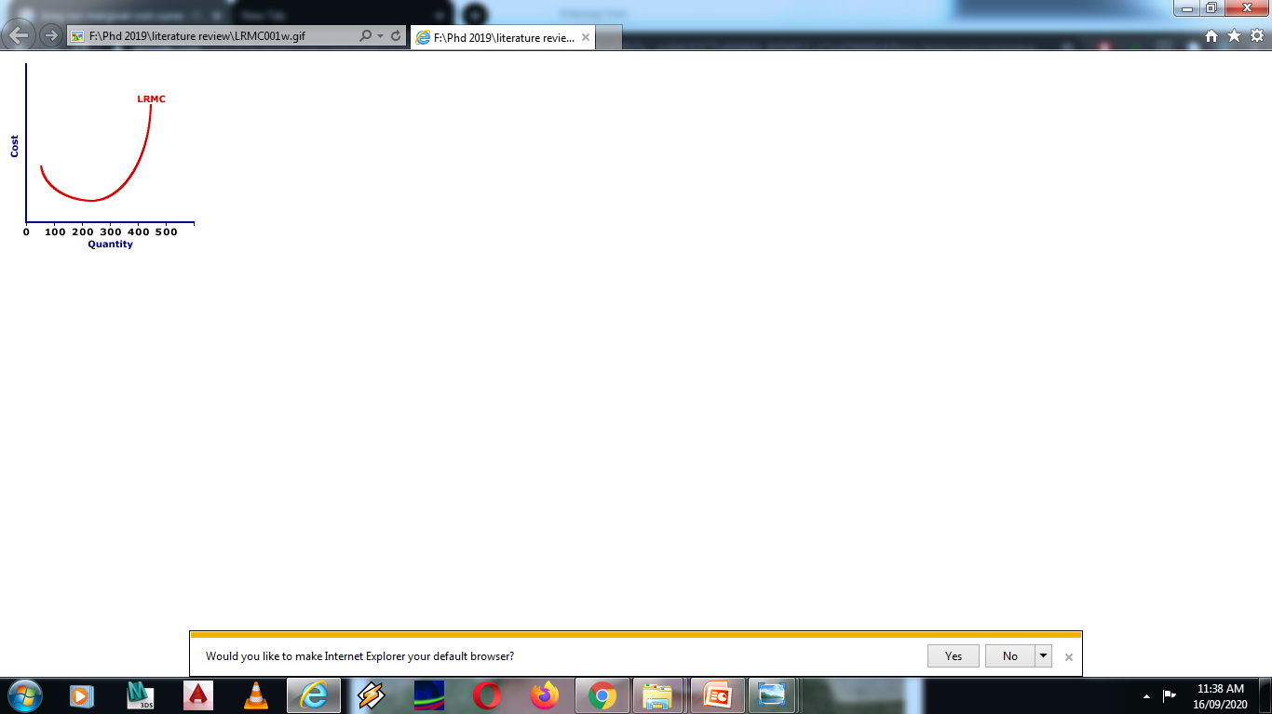
Long run Marginal Cost Curve
The long run marginal cost curve refers to the effect on total cost due to production of one more or less unit of output as a result of change in all the factors.

Slide 28
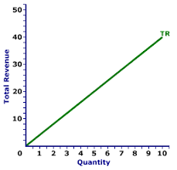
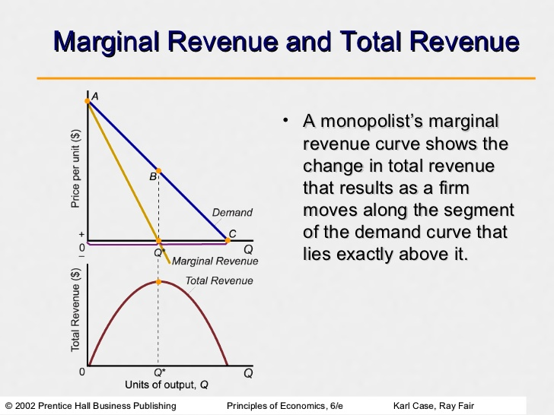
Total Revenue
Total revenue is the sum of total receipts earned by a firm from selling its output.
Total revenue = price per unit * quantity sold
TR curve in perfect competition
TR curve in monopoly

Slide 29
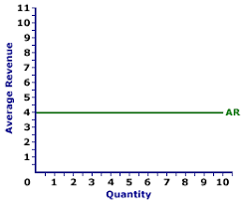
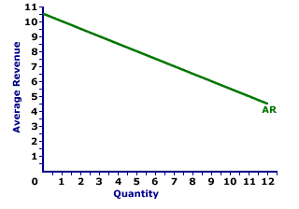
Average Revenue
Average revenue refers to the revenue per unit of the commodity sold. It is obtained by dividing the total revenue by number of units sold.
AR curve in perfect competition
AR curve in monopoly

Slide 30
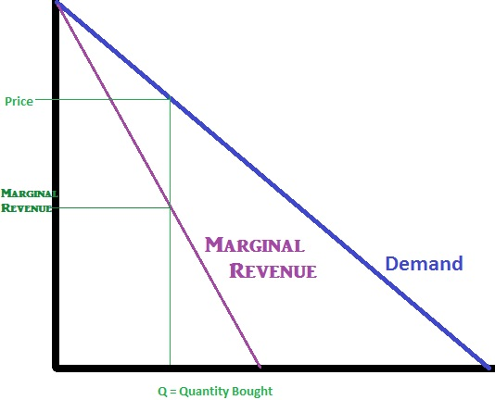
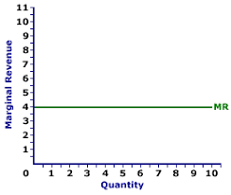
Marginal Revenue
Marginal revenue is the revenue earned by selling an additional unit of a commodity.
MR curve in perfect competition
MR curve in monopoly

